Slide 1
Characterization presentation: Barcode reader
By: Omar Sharafy, Muhammad Biadsy
Instructor: Mony Orbach
Lab: HSDSL
Spring Semester 2024

Slide 2
Motivation
In Hospitals, samples are collected from patients.
each sample is labeled with barcode stickers, unique to each patient.
The samples are manually checked in the lab against patient details in the computer system.
the numerous number of samples received daily can lead to confusion and mix-ups between samples, potentially resulting in life-threatening medical errors.

Slide 3

Goals
Develop an easy to carry and simple tool, that eliminate confusion and mix-ups between patient samples caused by manual handling in the Hospital laboratory.
The tool should be
able to Compare between barcodes and give us a clear result (via screen and sound).
able to communicatee via Wi-Fi with a computer.
able to Save barcodes.
Mobile, compact and Re-chargeable.

Slide 4
Mod of work Diagram
Scan the “original” barcode & save it to the SD card
Scan a barcode we want to compare to the original
Get the result via sound + screen
start
Scan the target barcode and save it to the SD Card

Slide 5
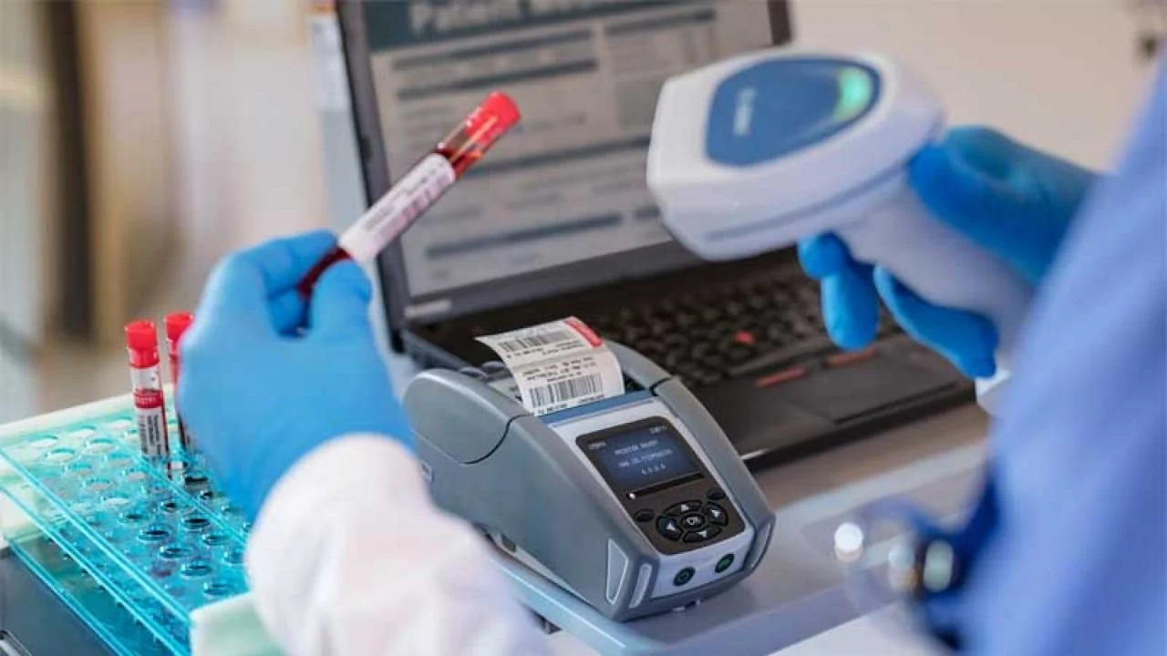
Mod of work
The device is designed to function in two distinct modes
Comparison Mode
The user scans an initial barcode.
The device compares (by scanning) another barcodes and provides feedback via the screen and an audible sound, indicating whether they match or not.
The "original" barcode is also saved to an external SD card.
Saving Mode
The user scans a barcode.
The device saves the scanned barcode to the external SD card.

Slide 6
Block diagram
Power Supply unit
Clk
Screen
ESP32
Barcode reader
BUZZER
SD card

Slide 7
components
Barcode reader. (add name)
Esp32.
Screen.
Realtime clk. (add name)
Charger.
Sd card.
Buzzer.

Slide 8
Challenges
Finding a cheap and reliable 3D barcode reader.
Making sure our device is cheap.
Concurrency between the components (esp32, real time clk, barcode reader…).
Combine tasks and timers.
Saving info into external SD card.

Slide 9
Tools and working environment chosen tools
Board : ESP32
Arduino developing environment

Slide 10
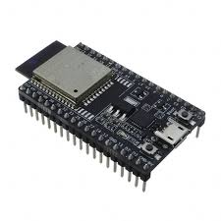
ESP32
Includes many drivers that make programming easier.
Advantages over Arduino nano: speed and memory
2 cores.
 | ESP32 | Arduino nano
Clock rate | 80 MHz | 16 MHz
Memory size | 520 KB SRAM 4 MB flash memory | 2 KB SRAM 32 KB flash

Slide 11
Barcode reader
//we will elaborate here on the barcode speciltes

Slide 12
Arduino developing environment
Supports the ESP32.
Rich collection of libraries for various sensors and communication protocols.
Easy to use and quickly start coding.
Supports wide range of applications.

Slide 13
Gant diagram
הערכת זמנים גסה
9June24 | 1July24 | 1august24 | 1sep24 | 15sep24
Choosing specific components
scheme
layout
Designing a case via 3D Printer
Debug
Code bring - up

